Slide 1
Ajanta Art
History of art
BFA-I
Section; C, D
Class Teacher: Aasma Abdul Majeed
Visual Arts, LCWU

Slide 2
Maps of A janta Caves

Slide 3
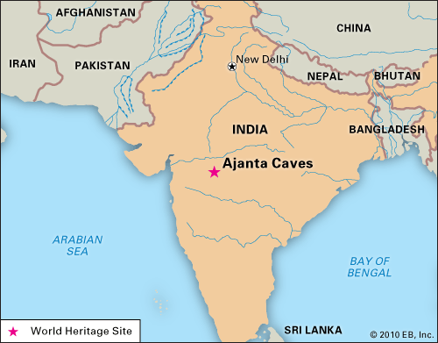

Slide 5
Hidden away in the hills of Northwest India, some 200 miles from the busy streets of Mumbai, emerge a magnificent jewel of art and religion: the Ajanta Caves. There are about 30 rock-cut Buddhist cave monuments which date from the 2nd century BCE to about 480 or 650 CE. The Ajanta cave paintings and rock cut sculptures are described as among the finest surviving examples of ancient Indian art, particularly expressive painting that present emotion through gesture, pose and form. According to UNESCO, these are masterpieces of Buddhist religious art that influenced Indian art that followed. The caves were built in two phases, the first group starting around the 2nd century BC, while the second group of caves built around 400–650 AD according to older accounts, or all in a brief period of 460 to 480 according to Walter M. Spink.

Slide 6
Mural paintings survive from both the earlier and later groups of caves. Several fragments of murals preserved from the earlier caves (Caves 9 and 11) are effectively unique survivals of ancient painting in India from this period, and “show that by Sātavāhana times, if not earlier, the Indian painter had mastered an easy and fluent naturalistic style, dealing with large groups of people in a manner comparable to the reliefs of the Sāñcī toraņa crossbars”. Four of the later caves have large and relatively well-preserved mural paintings which, states James Harle, “have come to represent Indian mural painting to the non-specialist”, and represent “the great glories not only of Gupta but of all Indian art”. They fall into two stylistic groups, with the most famous in Caves 16 and 17, and apparently later paintings in Caves 1 and 2. The Ajanta frescos are classical paintings and the work of confident artists, without cliches, rich and full. They are luxurious, sensuous and celebrate physical beauty, aspects that early Western observers felt were shockingly out of place in these caves presumed to be meant for religious worship and ascetic monastic life.

Slide 7
The main colors used were red ochre, yellow ochre, brown ochre, lamp black, white and lapis lazuli which was imported from Northern India, central Asia and Persia. The green was made by mixing this lapis lazuli with Indian yellow ochre. In the pictorial cycles, all the characters are bright and multi-colored but are never repeated, a fundamental concept in Indian art. Ceilings, walls and pilasters are all covered with overlapping figures, brought to life by the artists with strong and contrasting colors. The painting techniques at Ajanta are similar to European fresco technique. The primary difference is that the layer of plaster was dry when it was painted. First, a rough plaster of clay, cow dung, and rice husks were pressed on to the rough cave walls. This was then coated with lime juice in order to create a smooth working surface.

Slide 8
Front of Cave 1

Slide 9
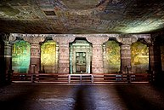
Cave 1, interior

Slide 10
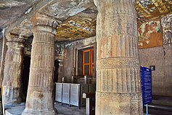
Outside view and main hall Cave 2.

Slide 11
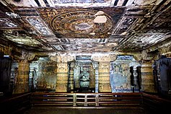
Main hall with shrine, Cave 2.

Slide 12
Cave 3 image not available

Slide 13
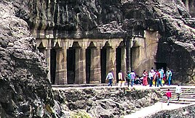
Exterior view of Cave 4

Slide 14
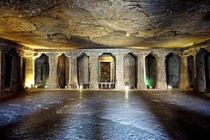
Interior hall of Cave 4

Slide 15
Cave 5
Cave 5, an unfinished excavation was planned as a monastery (10.32 × 16.8 m). Cave 5 is devoid of sculpture and architectural elements except the door frame. The ornate carvings on the frame has female figures with mythical makara creatures found in ancient and medieval era Indian arts.

Slide 16
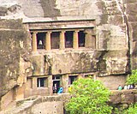
Cave -6 A view of the entrance and two storeys

Slide 17
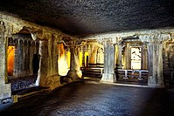
A view of upper-level hall, and artwork on sanctum's door frame

Slide 18
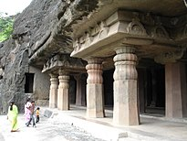
Cave -7

Slide 19
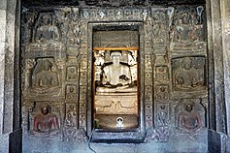
Cave-7 interior

Slide 20
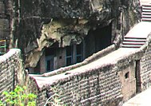
External view of Cave 8, Cave 8 is small, and located at the lowest level in Ajanta, just below the walkway between Caves 7 and 9.

Slide 21
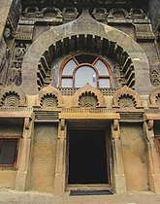
Entrance to the Cave 9 worship hall.

Slide 22
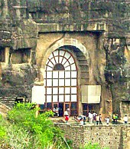
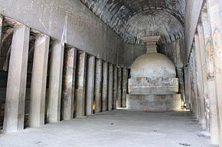
Exterior view and interior hall of Cave 10

Slide 23
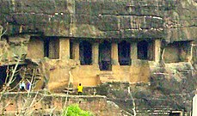
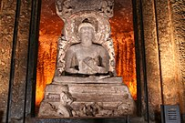
Outside view of Cave 11: Buddha with a kneeling devotee

Slide 24
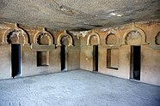
Cave -12

Slide 25
Cave 13

Slide 26
Cave 14

Slide 27
Cave 15

Slide 28
Cave 15A

Slide 29
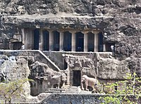
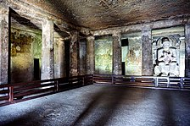
Entrance stairs to the single-storey Cave 16, with stone elephants and front with pillars (left). Inside hall with seated Buddha statue (right).

Slide 30
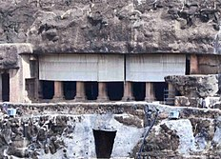
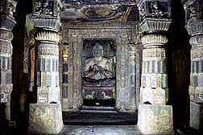
Cave 17: exterior view and inside hall with seated Buddha statue

Slide 31
Cave 8 Cave 18 is a small rectangular space (3.38 × 11.66 m) with two octagonal pillars and it joins into another cell. Its role is unclear.

Slide 32
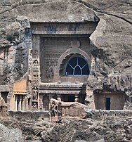
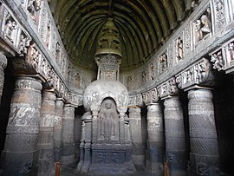
Entrance façade and inside worship hall, Cave 19, sponsored by king Upendragupta

Slide 33
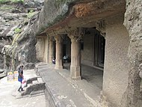
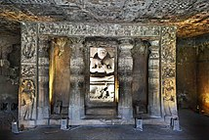
Cave 20

Slide 34
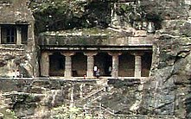
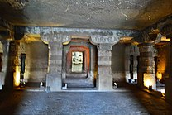
Cave 21

Slide 35
Cave 22, 23 images not available

Slide 36
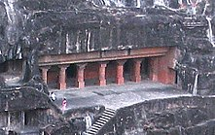
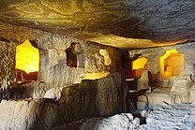
Cave 24

Slide 37
Cave 25 image not available

Slide 38
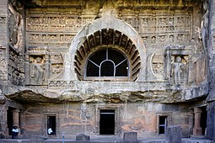
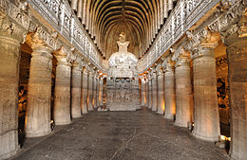
Cave 26

Slide 39
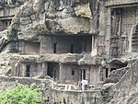
Cave 27

Slide 40
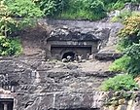
Cave 28

Slide 41
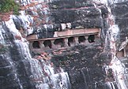
Cave 29

Slide 42
Cave 30 Cave 30 may actually be the oldest cave of the Ajanta complex. It is a 3.66 m × 3.66 m cave with three cells, each with two stone beds and stone pillows on the side of each cell. The cell door lintels show lotus and garland carvings. The cave has two inscriptions in an unknown script. It also has a platform on its veranda with a fine view of the river ravine below and the forest cover. According to Gupte and Mahajan, this cave may have been closed.

Slide 43
Cave Paintings

Slide 44
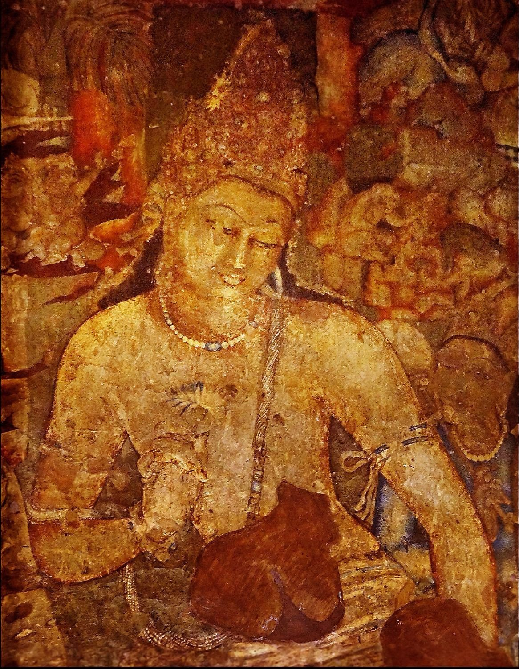
Bodhisattva Padmapani, Cave 1, Ajanta c. late 5th CE

Slide 45
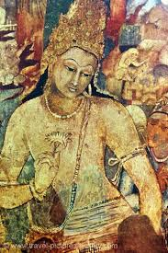

Slide 46
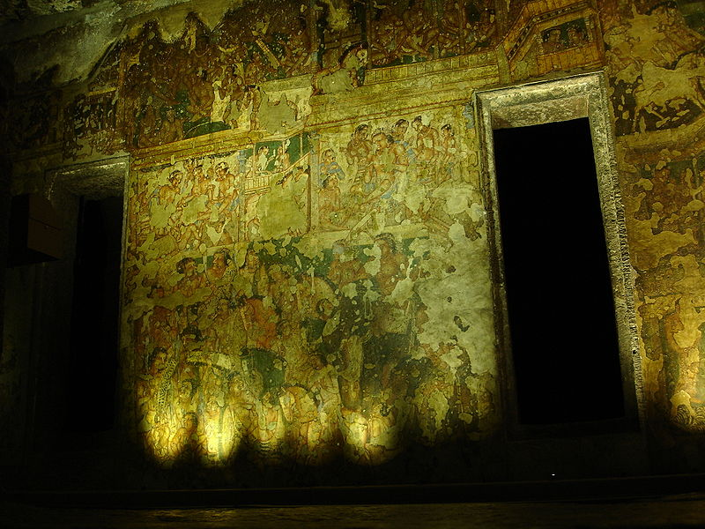
Cave 2 showing the extensive paint loss of many areas. It was never finished by its artists, and shows Vidhura Jataka.

Slide 47
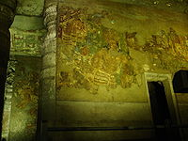
Cave-13

Slide 48
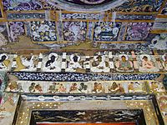
Cave 17 verandah doorway; eight Buddhas above eight couples

Slide 49
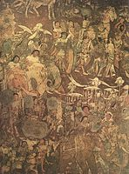
Section of the mural in Cave 17, the 'coming of Sinhala'. The prince (Prince Vijaya) is seen in both groups of elephants and riders.

Slide 50
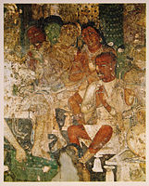
Hamsa jâtaka, cave 17: the Buddha as the golden goose in his previous life

Slide 51
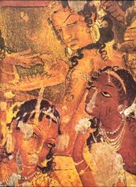

Slide 52
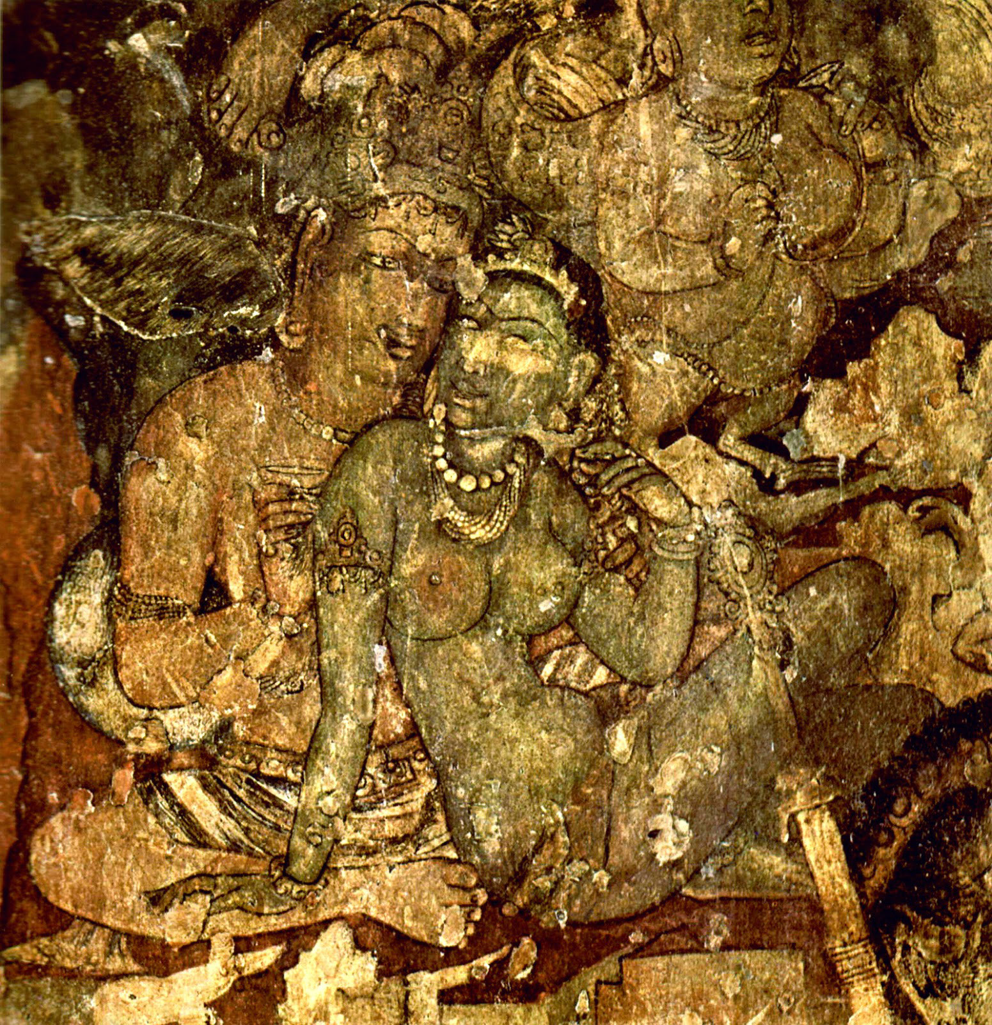

Slide 53
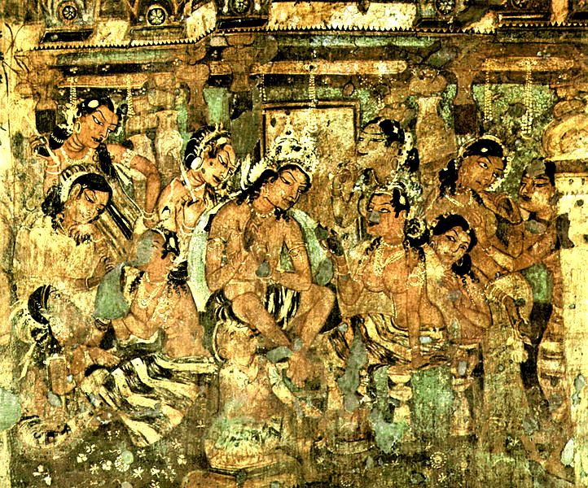

Slide 54
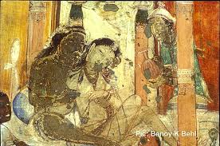

Slide 55
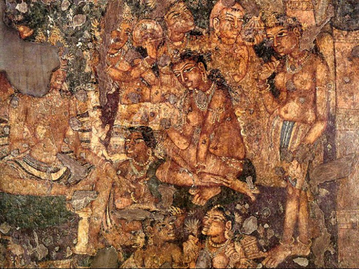

Slide 56
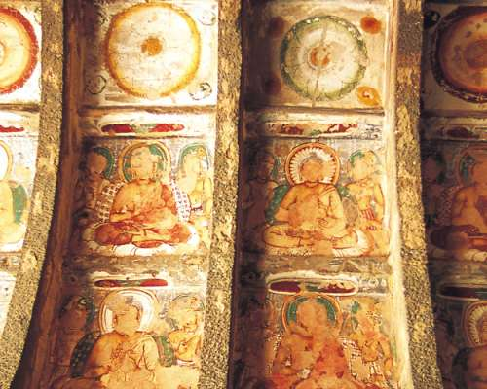

Slide 57
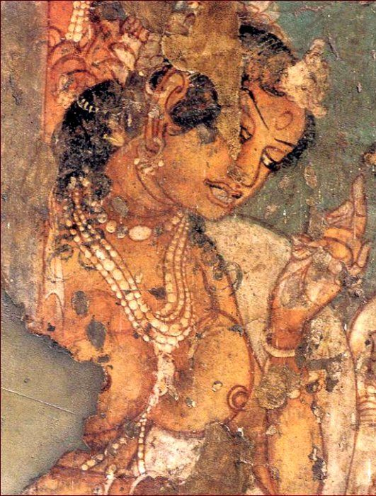

Slide 58
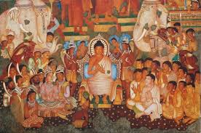

Slide 59
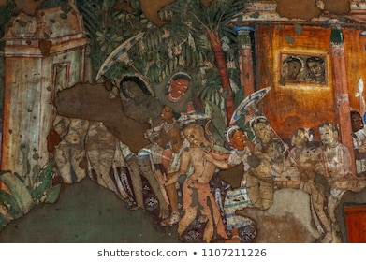

Slide 60
Ajanta Paintings: An Insight

Slide 62
The Ajanta cave paintings - a brief note

